Slide 1
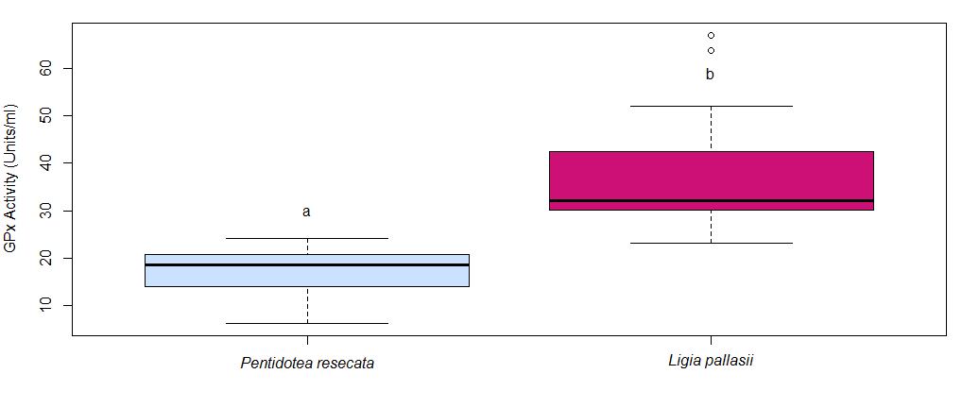
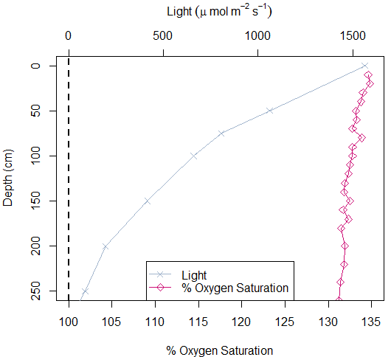
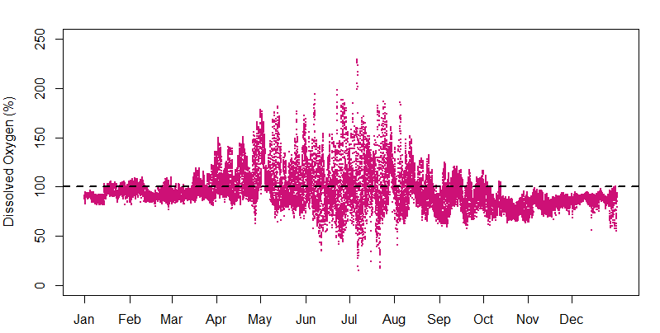
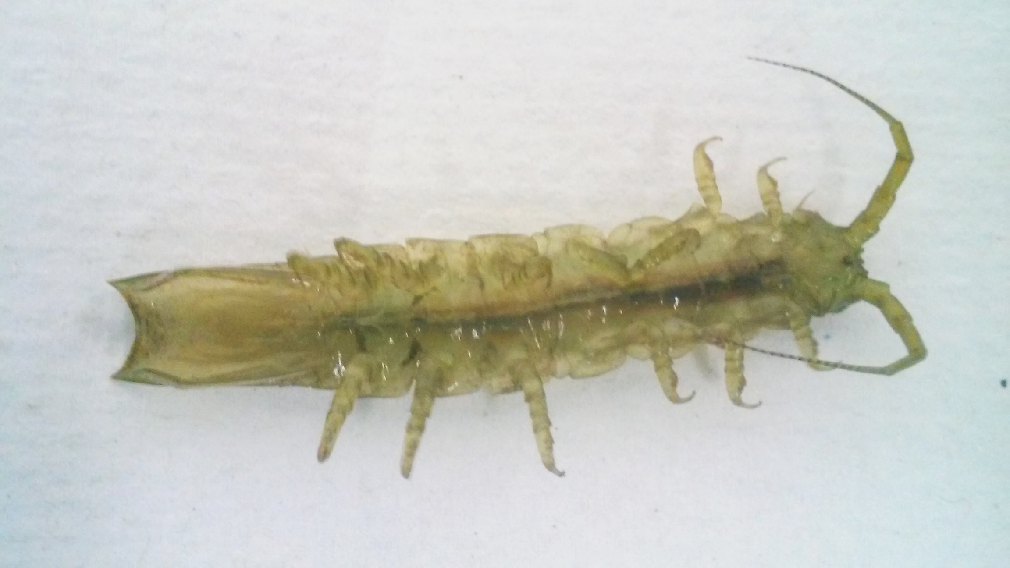
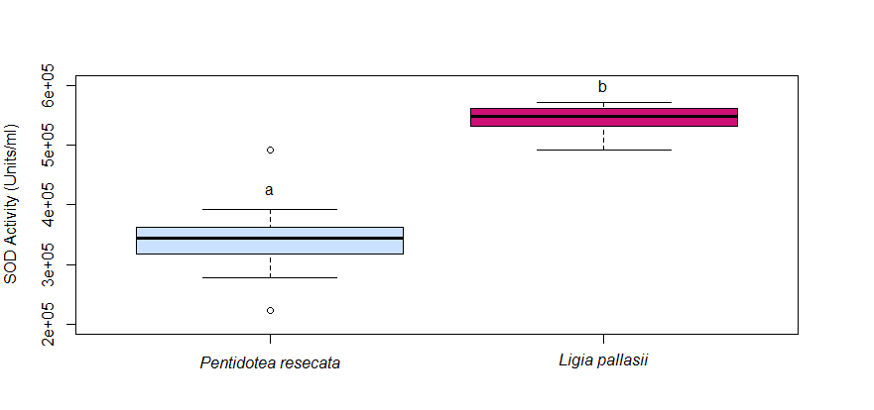
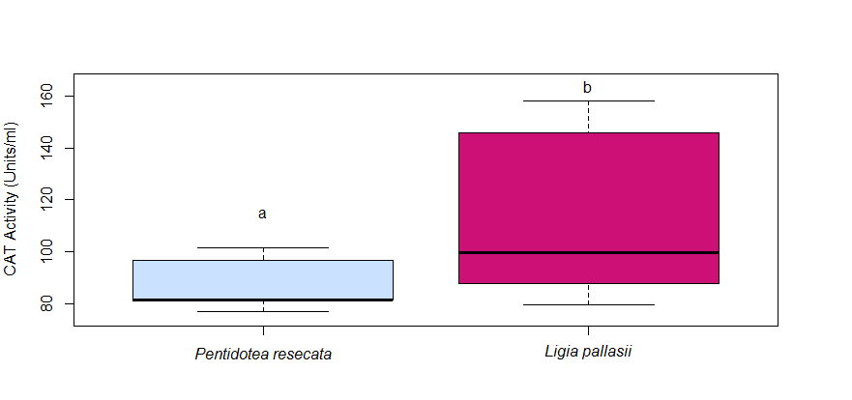
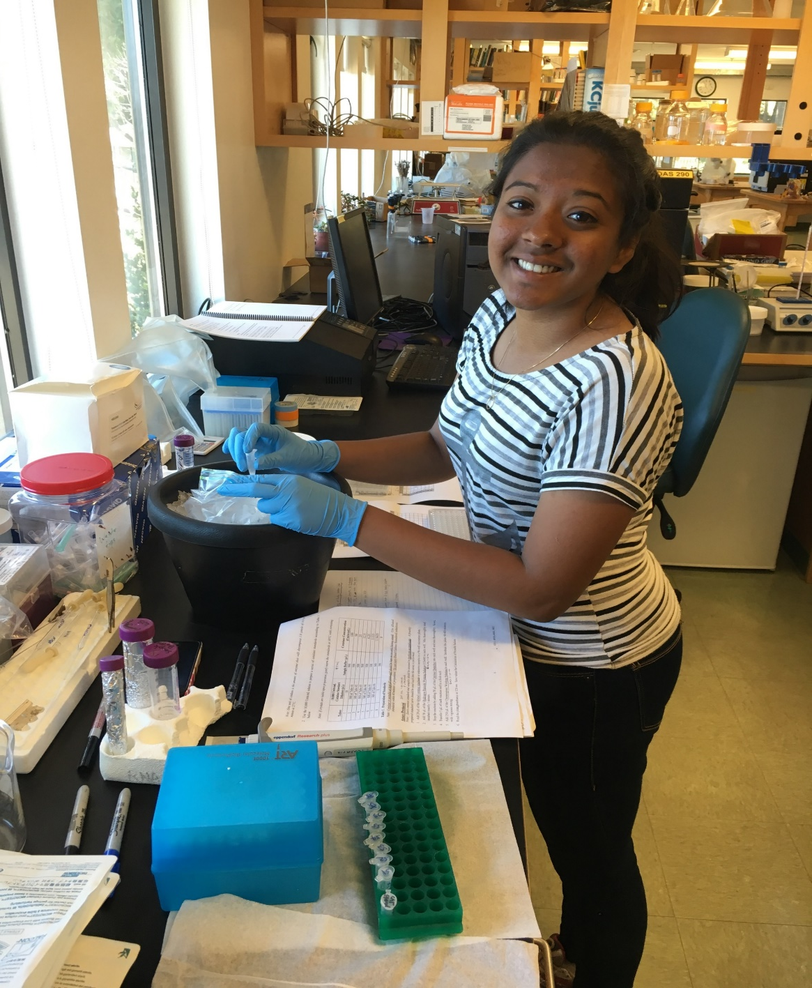
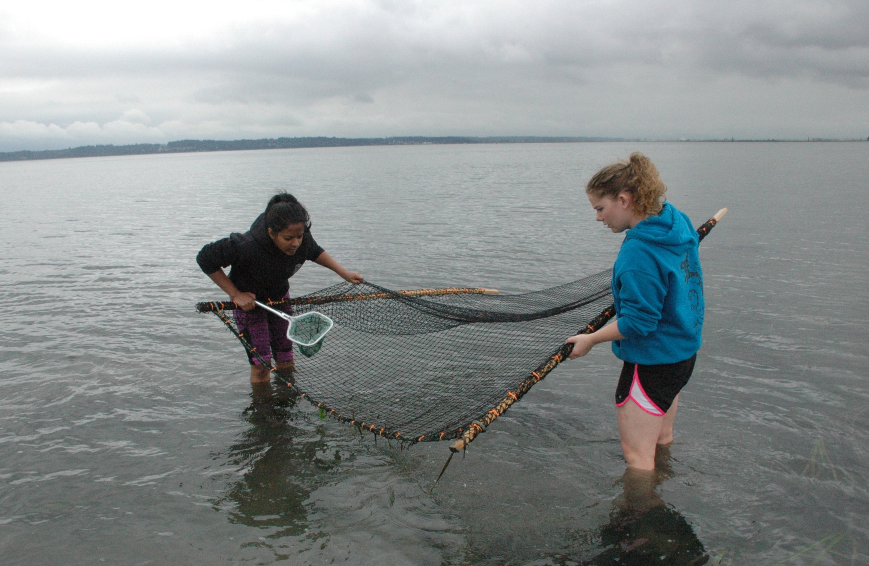
HOW DOES THE GREEN EELGRASS ISOPOD PROTECT ITS TISSUE AGAINST HIGHLY FLUCTUATING OXYGEN CONDITIONS?
C. Judelle Johnson, Leah E. Dann, and David L. Cowles; Walla Walla University, College Place, WA
Abstract
Methods
Organisms that live in habitats which exhibit hyperoxic or hypoxic oxygen conditions are likely to be exposed to high levels of reactive oxygen species (ROS). ROS can cause oxidative stress, causing damage to proteins, lipids, and DNA. The green eelgrass isopod Pentidotea resecata lives among shallow Zostera marina eelgrass beds. Because Z. marina produces oxygen during photosynthesis, P. resecata lives in a hyperoxic and highly fluctuating oxygen environment, with a range of below 20% to over 200% oxygen saturation. They likely protect themselves against these damaging ROS with antioxidants. We investigated the enzymatic antioxidant capacity of superoxide dismutase (SOD), catalase (CAT), and glutathione peroxidase (GPx) in the tissue of Pentidotea resecata. The activities of these enzymes were compared to that of Ligia pallasii, a marine isopod that lives in cracks in rocks, is only occasionally exposed to the water, and therefore rarely encounters hyperoxic conditions. Because P. resecata experiences hyperoxic and highly fluctuating oxygen conditions and therefore higher levels of ROS, we expected to observe higher enzymatic antioxidant levels in P. resecata compared to L. pallasii. Instead, the activity of SOD, CAT, and GPx of L. pallasii was significantly higher than that of P. resecata. Perhaps P. resecata have other preventive mechanisms and physical defenses to protect against ROS from hyperoxic and highly fluctuating oxygen conditions.
Dissolved oxygen was measured among the Z. marina eelgrass beds using a YSI 550A oxygen field electrode at low and high tides; morning, afternoon, and dawn; and on cloudy and sunny days. Oxygen saturation data were also downloaded from a buoy operated by NOAA National Estuarine Research Reserve in a nearby channel.⁵ Pentidotea resecata were collected from the same eelgrass beds in Padilla Bay, WA and Ligia pallasii were collected from Northwest Island in Rosario Bay, WA. Animals were sacrificed and dissected following collection. L. pallasii animals were placed in a chamber with dry ice and anesthetized before they were dissected. P. resecata animals were placed in ice cold sea water to slow their metabolism before they were decapitated and then dissected. Samples were frozen at -80°C. The activity of superoxide dismutase, catalase, and glutathione peroxidase were determined by assay kits from Sigma Aldrich, Cell Biolabs, and Cayman Chemicals, respectively.
Figure 4. Glutathione peroxidase activity in P. resecata vs. L. pallasii. GPx activity of L. pallasii (n=20) was significantly higher than that of P. resecata (n=22). The letters a and b represent statistically significant values. (Permutation test. W= 63, p≤ 0.00001.)
Results
Discussion
Z. marina eelgrass beds exhibit highly fluctuating dissolved oxygen saturation during the day, exposing P. resecata to dissolved oxygen levels ranging from well below 20% to over 200% (Figure 1b), therefore likely exposing P. resecata to high amounts of ROS. Because L. pallasii live among rocky cracks and never immerse themselves in seawater, they are likely exposed to only around 100% oxygen saturation. It would seem that P. resecata, relative to L. pallasii, should experience more damage from ROS. However, we found that L. pallasii tissues exhibit significantly higher enzymatic antioxidant capacity (SOD, CAT, and GPx) than do P. resecata tissues (Figures 2, 3, and 4). Perhaps P. resecata are protecting themselves from ROS damage using other mechanisms⁶ such as carotenoids⁷ or their immune system.
A
B
Introduction
Zostera marina eelgrass beds are a common habitat for many marine species such as fish, anemones, crabs, and isopods. Z. marina produces oxygen during photosynthesis which is released into the water column, and does not dissipate readily. Because green eelgrass isopods, Pentidotea resecata, live and feed on Z. marina beds, they are likely exposed to fluctuating levels of dissolved oxygen.
Figure 1. Percent saturation of dissolved oxygen levels in Padilla Bay. A. Dissolved oxygen saturation data along with light level collected by our research team on July 29, 2016. B. Dissolved oxygen saturation data obtained from NOAA National Estuarine Research Reserve System from January to December 2016.⁵
Conclusions
Z. marina eelgrass beds exhibit highly fluctuating dissolved oxygen levels.
Enzymatic antioxidant capacity is higher in L. pallasii than in P. resecata.
These results were not expected, and may be because
P. resecata do not experience significant damage from ROS, or
P. resecata have other mechanisms⁷ to protect themselves from highly fluctuating oxygen conditions
Future experiments measuring ROS and lipid damage may need to be done to confirm these speculations.
Pentidotea resecata
Ligia pallasii, commonly called the rock louse, lives in a
high intertidal to supratidal habitat and only comes in contact with seawater during dawn and dusk to feed on algae and to dip its gills to keep them moist.¹ They spend the majority of the day hiding in rocky cracks along the shore in large communities. Because of this lifestyle, they are likely exposed to 100% oxygen saturation, or normoxic conditions, and will experience little, if any, exposure to hyperoxic conditions.
Acknowledgements
All living organisms that are exposed to oxygen have defense mechanisms such as antioxidants to help quench reactive oxygen species (ROS). ROS such as superoxide anion radicals (O₂-), singlet oxygen (¹O₂), hydroxyl radicals (HO∙), and hydrogen peroxide (H₂O₂) can cause significant oxidative damage such as lipid peroxidation, DNA damage, enzyme inactivation,² apoptosis and cell necrosis.^{3,4} Common enzymatic antioxidants that are responsible for extinguishing ROS are superoxide dismutase (SOD), catalase (CAT), and glutathione peroxidase (GPx). SOD is responsible for the dismutation of O₂- into either O₂ or H₂O₂. CAT catalyzes the decomposition of H₂O₂ into H₂O and O₂ .³ GPx reduces free H₂O₂ to H₂O using glutathione.
Figure 2. Superoxide Dismutase activity in P. resecata vs. L. pallasii. SOD activity of L. pallasii (n=10) was significantly higher than that of P. resecata (n=10). The letters a and b represent statistically significant values. (Welch Two Sample t-test. t= -8.2975, df= 11.592, p= 3.258e-06.)
We would like to acknowledge Sarah Anderson and Faith Hunnicutt for their help in the collection of P. resecata. We would also like to thank University of Washington Friday Harbor Lab and Whitman College for allowing us to use their facilities and equipment. We thank Dr. Jim Nestler and Dr. Kirt Onthank for their support and guidance, and Dr. Joan Redd for her help with the 96-well plate reader at WWU. And lastly, Walla Walla University for providing funding, resources, and facilities.
References
1. Morris, R. H., Abbott, D. P., & Haderlie, E. C. (1980). Intertidal invertebrates of California. Stanford University Press, Stanford, CA. 690 pp.
2. Halliwell, B. (1999). Antioxidant defence mechanisms: from the beginning to the end (of the beginning). Free radical research, 31(4), 261-272.
3. Lesser, M. P. (2006). Oxidative stress in marine environments: biochemistry and physiological ecology. Annu. Rev. Physiol., 68, 253-278.
4. Livingstone, D. R. (2003). Oxidative stress in aquatic organisms in relation to pollution and aquaculture. Revue de Medecine Veterinaire, 154(6), 427-430.
5. NOAA National Estuarine Research Reserve System (NERRS). System- wide Monitoring Program. Data accessed from the NOAA NERRS Centralized Data Management Office website: http://cdmo.baruch.sc.edu/.
6. Babin et al. (2010). Dietary supplementation with carotenoids improves immunity without increasing its cost in a crustacean. The American Naturalist, 176(2), 234-241.
7. Dann, L. (2017). Does Pentidotea resecata hemolymph protect the isopod from oxidative stress? Poster at ASLO, Honolulu, HI, February 2017.
Because L. pallasii are exposed to normoxic conditions, we expected them to have lower enzymatic antioxidant capacity than that of P. resecata, which are readily exposed to highly fluctuating oxygen conditions while living among Z. marina eelgrass beds. The purpose of this study was to investigate the enzymatic antioxidant capacity of P. resecata tissue and compare it to that of L. pallasii.
Figure 3. Catalase activity in P. resecata vs. L. pallasii. CAT activity of L. pallasii (n=15) was significantly higher than that of P. resecata (n=15). The letters a and b represent statistically significant values. (Wilcoxon rank sum test. W= 63, p= 0.04084.)

